Slide 1
Application Programming Interface and Final Application

Slide 2
Module Syllabus
Design and Implementation of Simple Application Programming Interface (API)
Final Application to Run on SoC: the Snake Game
Reduce Application Power Consumption

Slide 3
Building a System on a Chip (SoC)
Software high-level
application development
Application Design (e.g., Game)
Application Programming Interface (API)
Software low-level drivers & libraries programming
Arm CMSIS-Core
Peripheral Drivers
Arm Cortex-M0
Processor
Timer
Peripheral
GPIO
Peripheral
7-Segment
Peripheral
Hardware design
AHB
Memory
VGA
Peripheral
UART
Peripheral
Interrupt
Notes:
This module explores the principles of the application programming interface (API). An API is a software abstract layer that can provide a standard programming interface for applications developers. We will also discuss how to develop an API using the functions provided by software drivers and CMSIS. Finally, we will develop a Snake game application to run on our SoC.

Slide 4
API Overview
An API is a software abstract layer that can provide a standard programming interface for applications developers.
For example, most OSs provide their own APIs to allow programmers to easily develop their applications.
An API can provide a number of interface services, such as base services, graphic interface, network services, etc.
There are a variety of commercial APIs available in the market, such as Java API, Windows API, Google AJAX APIs, etc.

Slide 5
Develop a Simple API
In this module, we will develop a simple API for application development.
The API can provide generic, easy-to-use functions for the end-user by combining the functions from both CMSIS and peripheral drivers.
For example, we can have a SoC initialization function to reset both the processor and the peripherals.
Software API libraries
Application Programming Interface (API)
Software drivers
Arm CMSIS
Peripheral Drivers
Arm Cortex-M0
Processor
Timer
Peripheral
GPIO
Peripheral
7-Segment
Peripheral
Hardware
AHB
Memory
VGA
Peripheral
UART
Peripheral
Notes:
In this module, we will develop a simple API for application development. The API can provide generic, easy-to-use functions for the end-user by combining the functions of both CMSIS and peripheral drivers. For example, we can have a SoC initialization function to reset both the processor and the peripherals.

Slide 6






Hardware-Dependent Functions
High-level API:
Generic
Easy-to-use
High programming efficiency
Not specific to hardware
Less control over low-level hardware
printf (“helloworld!”)
API
Libraries
OS Shell Libraries
OS Kernel Libraries
How to choose a specific device (e.g., VGA) to print?
Driver Libraries
Processor
Mouse
UART
VGA
……
Low-level libraries:
Less generic
Low programming efficiency
More specific to hardware
More control over low-level hardware
Hardware
Notes:
The use of APIs has a number of advantages over low-level programming, such as high-level generic functions that are not specific to hardware, are easy-to-use, and lead to high programming efficiency. However, while becoming generic, some hardware-dependent functions may still need to be specified by the user. For example, for the function “printf(),” we usually need to specify which device to print to, for e.g., UART or VGA.

Slide 7
Call-Back Functions
To allow users to specify necessary low-level features, many APIs offer call-back functions that enable users to control or specify the low-level hardware device in their application code.
Usually, the call-back functions are accessible in the application program, where users can modify or write their own code.
Application
Main Function
Call-Back Functions
Call Functions
Call Back
Libraries
Library Functions
Notes:
To allow users to specify some necessary low-level features, many APIs offer call-back functions. A call-back function can be any function that is passed to another function (the calling function) as a variable. The calling function typically executes the call-back function in response to an event such as an interruption signal. This enables users to control or specify the low-level hardware device in their application code in the call-back function. The latter are typically accessible in the application program, where users can modify or write their own code. In all cases, the intention is to specify a function or subroutine as an entity that is, depending on the language, more or less similar to a variable.

Slide 8
Retargeting
Similar to the call-back functions, in μVision development tools, we use a “retarget.c” file to define these hardware-dependent functions, such as the “printf” function.
The retarget functions include:
Function | Description
int fputc(int ch, FILE *f) | Writes a character to the console
int fgetc(FILE *f) | Read a character to the console
int ferror(FILE *f) | Checks error indicator
void _sys_exit(int return_code) | The library exit function. All exits from the library eventually call _sys_exit().
Notes:
Similar to the call-back functions, in μVision development tools, we use a “retarget.c” file to define these hardware-dependent functions, such as the “printf” function. The table here demonstrates a number of C library retargets. The first is int fputc(int char, FILE *f), which writes a character to a specified location (FILE *f) and increments the pointer to the FILE object. If the same character is returned, this means there was no execution error; if the EOF is returned, it means an error has occurred.
The second is int fgetc(FILE *f), which reads a character from a specified location (FILE *f) and increments the pointer to the FILE object. If the same read character is returned, this means there was no execution error; if the EOF is returned, it means either an error has occurred or the pointer has reached the end of the file.
The third function is called the int ferror(FILE *stream), which checks the error indicator for the given stream (f). It returns a non-zero value if the error indicator associated with the team(f) is set; otherwise, it returns a zero.
Another retarget function is void _sys_exit(int return_code), which is the library exit function. All exits from the library eventually call _sys_exit().

Slide 9
Retargeting Examples
For example, you can retarget functions to the UART console.
Alternatively, you can retarget the output console to VGA.
int fputc(int ch, FILE *f) {
return (UartPutc(ch));
}
int fgetc(FILE *f) {
return (UartGetc());
}
int fputc(int ch, FILE *f) {
return (VGAPutc(ch));
}
Notes:
In the first example, we can see how to use the fput and fget retarget functions to write and read a character to/from the UART. The second example shows how to retarget the output console to VGA.

Slide 10
Example of API Functions
API Functions | Descriptions
void SoC_init(void) | SoC initialization
void rectangle(int x1,int y1,int x2,int y2, int color) | Draw a rectangle on the screen.
void clear_screen (void) | Clean up the screen.
int read_switch | Read the value of the 8-bit switches.
write_LED | Write a value to the 8-bit LEDs.
void Display_Int_Times (void) | Display the number of interrupts the occurred using the 7-segment display.
void delay(int value) | Software delay program
char random (char min, char max) | A simple random generator based on system tick
int KBHIT(void) | Wait for keyboard hit.
Retarget functions | Input/output console texts.
Notes:
In addition to the retarget functions that we have discussed, API includes many other functions that ease our application development in a variety of ways, such as:
Less development time, hence higher productivity
Easy to read and be reused by any other user
Better code density, since most libraries are carefully designed and coded by experts
Better performance (efficient coding)
Portable from device to device
Easy to maintain and upgrade

Slide 11
Game Application: Snake
In the lab associated with this module, you will write a Snake game application to demonstrate your SoC.
Application Design (e.g., Game)
Application Programming Interface (API)
Arm CMSIS-Core
Peripheral Drivers
Arm Cortex-M0
Processor
Timer
Peripheral
GPIO
Peripheral
7-Segment
Peripheral
AHB
Memory
VGA
Peripheral
UART
Peripheral

Slide 12
Game Application: Snake
Here are some suggested game features:
Basic features: snake moving, target reaching, length increasing, etc.
Game instructions and current score are displayed in the VGA console.
The position of targets can be randomly generated using system ticks.
Increase the speed each time a target is reached.
Game over on: (1) snake’s head touches the boundary, or (2) snake’s head touches its own body.
Game can be paused and resumed.

Slide 13
Game Application: Snake
Try to make full use of all the hardware peripherals and software functions; for example:
VGA: displaying the game elements (e.g., snake and boundaries) in the image region and displaying the game information (e.g., current score, additional instructions) in the text console region
UART: receiving commands (e.g., move up, down, left, right) from the keyboard
Timer: triggering the movement of the snake or recording the time elapsed in a game
7-segment: displaying the time elapsed in a game
GPIO output (LEDs): showing the current score
GPIO input (switches): changing difficulty level, snake color, etc.

Slide 14
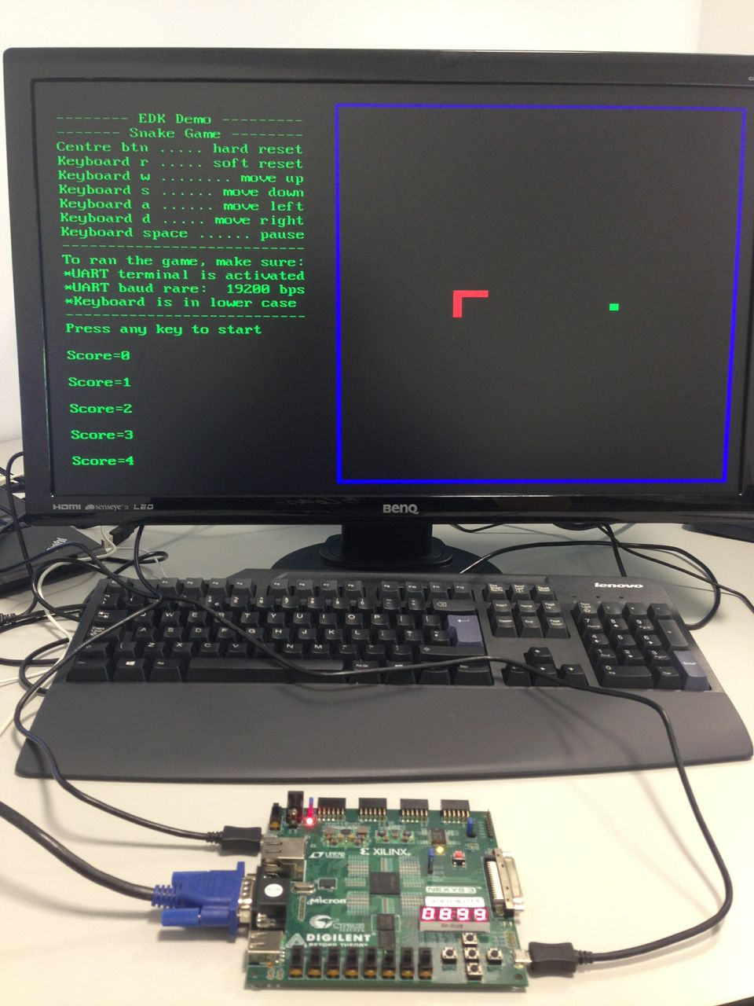
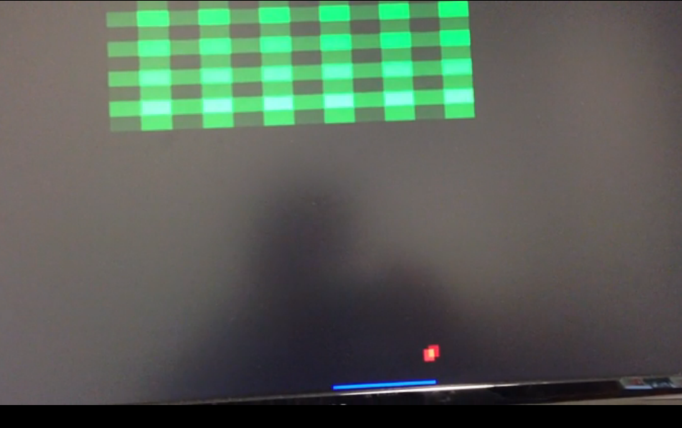
More Game Applications
A number of games can be programmed by just using UART as input and VGA as output; for example:
PACMAN
TETRIS
BREAK
TicTac
SNAKE
BREAK
Notes:
You can program numerous games by simply using UART as an input and VGA as an output; for example, PACMAN , TETRIS, and BREAK.

Slide 15
Cortex-M0 Low-Power Features Review
Two architectural sleep modes:
Normal sleep and deep sleep
Two instructions for entering sleep modes:
WFE (wait for event) and WFI (wait for interrupt)
Sleep-on-exit feature
Allow processor to stay in sleep mode as much as possible
Wakeup interrupt controller (WIC)
An optional feature that allows the clock of the processor to be completely removed during deep sleep
Low-power design implementation
Since the gate count is very low, the static leakage power is tiny when compared to other 32-bit processors.
Notes:
We are now going to discuss how we can develop power-efficient applications by exploiting power saving features in both, the hardware and software parts of the system. First, this slide reviews the main power saving features available in the Cortex-M0 processor.
The Cortex-M0 has an architectural support for sleep modes, which allows the processor to reduce its power consumption when it is not doing anything. There are two possible sleep modes: normal and deep. In addition, there are special instructions for getting into these sleep modes, as we have seen previously, namely WFE and WFI. In addition, to support the sleep modes, the processor architecture has an optional hardware block called wakeup interrupt controller (WIC) that facilitates clock gating implementation during deep sleep mode, which further reduces power consumption. Sleep on exit is another important feature that speeds up the transition from sleep mode; this allows the processor to stay in this low-power mode for as long as possible. Finally, the relatively small area overhead of the Cortex-M0 significantly reduces its static leakage power, as compared to other 32-bit processors.

Slide 16
Cortex-M0 Sleep Mode
The Cortex-M0 processor supports two sleep modes: normal sleep mode and deep sleep mode.
The exact meaning and behaviors of the two modes depends on the implementation of the microcontroller. For example,
Normal sleep: switch off some of the clock signals
Deep sleep: reduce voltage supply to the memory blocks, switch off additional components
To enter sleep mode, we can use WFE or WFI instructions.
The processor can exit the sleep mode if an event occurs.
Notes:
There are three ways to enter sleep mode: using WFE (wait for event) instruction; using WFI (wait for interrupt) instructions; or using the sleep-on-exit feature. The processor can exit the sleep mode if an event occurs.

Slide 17
System Control Register
The sleep feature can be programmed by accessing the system control register (SCR) in the system control block (at address 0xE000ED10).
System control register (0xE000ED10)
Bits | Field | Description
0 | Reserved | -
1 | SleepOnExit | Sleep-on-exit enable bit
2 | SleepDeep | Sleep mode type bit, 0: normal sleep; 1: deep sleep
3 | Reserved | -
4 | SeVOnPend | Send event on pend bit; enable generation of event by a new interrupt pending status
[31:5] | Reserved | -
SCR can be accessed by register symbol “SCB->SCR”; for example:
SCB -> SCR = 1<1; //Enable sleep-on-exit bit
Notes:
The table above illustrates the contents of the SCR register. Sleep on-exit is enabled by setting bit[1]. To enable normal sleep mode, we need to set bit[2] to zero; for deep sleep mode, we set the same bit to logic one. The Cortex M0 also has a send-event-on-pend feature that allows any interrupts (including disabled ones) to wake up the processor, which stays in the sleep mode by executing the WFE instruction. This feature is controlled by bit[4] in the SCR register, when the SeVOnPend bit is set. If an interrupt switches from an inactive to pending state, an event will be generated and the processor will be woken up from WFE sleep.

Slide 18
Sleep-on-Exit
The sleep-on-exit feature does not carry out the unstacking process after the program returns from ISR.
The power consumption is reduced since
The execution of unnecessary programs in the main thread is avoided.
The unnecessary stacking and unstacking operation is avoided.
Priority
WFI
IRQ
ISR
Sleep-on-Exit
(no unstacking)
Main Thread
Sleep
Stacking
Sleep
Time
Notes:
The sleep-on-exit feature allows the processor to enter sleep mode as soon as all the exception handlers are completed. The use of this feature helps reduce the power consumption of the processor because the execution of unnecessary programs in the main thread is avoided, and also, the unnecessary stacking and unstacking operation is avoided. The sleep-on-exit feature is typically used in interrupt-driven applications, as this maximizes the amount of time the processor can stay in sleep mode.

Slide 19
Polling v Interrupts
A comparison of the two programming solutions for the same Snake application:
Initialization
Initialization
Keyboard hit
No
Interrupted by timer
Keyboard hit
Yes
Update snake direction
Move
snake
Sleep
Update
direction
Move the snake
Hit wall
No
Hit wall
No
Yes
Yes
Game over
Game over
Delay for a short time
Polling Mode
Interrupt Driven Mode
Notes:
Power saving approaches also exist on the application level. In fact, the flow of the application processing usually has a large impact on power consumption. There are many ways to structure the flow of application processing; we are going to consider two fundamental types of processing structures.
The first is called polling. In this case, the program execution will be halted when an I/O operation is required. Following this, the processor will keep checking the statuses of the I/O until it is ready. This approach wastes a great deal of CPU time, for if we are using this processing structure to display a number counting up every second, the software will need to repeatedly check the value held in the hardware timer to check when it reaches a value. This processing approach is not suitable for complex applications, as it is difficult to build a system with many activities that can respond quickly, because response time depends on all other processing.
The second fundamental type processing structure is interrupt driven. In this case, the hardware device being controlled (e.g., a UART peripheral) will cause a hardware interrupt to occur whenever it needs to be serviced, at which point, the processor can an interrupt service routine. For example, if we are using this processing structure to display a number counting up every second, all we need to do is configure the timer peripheral to generate an interrupt every second; the processor will run specific code (interrupt service routine: ISR) in response to display the number on a monitor or other display device. The interrupt driven approach is more efficient, as code runs only when necessary. It is also fast, as ISR response time does not depend on most other processing. In addition, code modules can be developed independently.
This approach is particularly useful in low power applications, as the processor can enter sleep mode when no processing is required.

Slide 20
Developing Low-Power Applications
In our application, we can reduce power consumption by using low-power features of Cortex-M0. Some suggestions are listed below:
Change your code structure and make it an interrupt-driven application. For example, in the Snake game,
the movement of the snake can be triggered by the interrupt from the timer.
use UART interrupt to receive commands from the keyboard.
Interrupted by timer
Keyboard hit
Timer ISR
Idle (sleep)
UART ISR
Sleep
Sleep
Notes:
To reduce power consumption, you can use the power saving features of both the hardware and software parts of the system. On the software side, you can change your code structure and make it an interrupt-driven application; for example, in the Snake game, the movement of the snake can be triggered by the interrupt from the timer. You can also use UART interrupt to receive commands from the keyboard.

Slide 21
Developing Low-Power Applications
Try to make the processor stay in the sleep mode as much as possible. This will reduce the processor duty cycle. For example,
Use the sleep-on-exit feature to avoid unnecessary stacking/unstacking overheads and reduce the wakeup latency.
Disable some of the peripherals if they are not frequently used; e.g., disable their clock sources.
Power
Interrupt
duty cycle
Sleeping mode
Average power
Time

